Slide 1
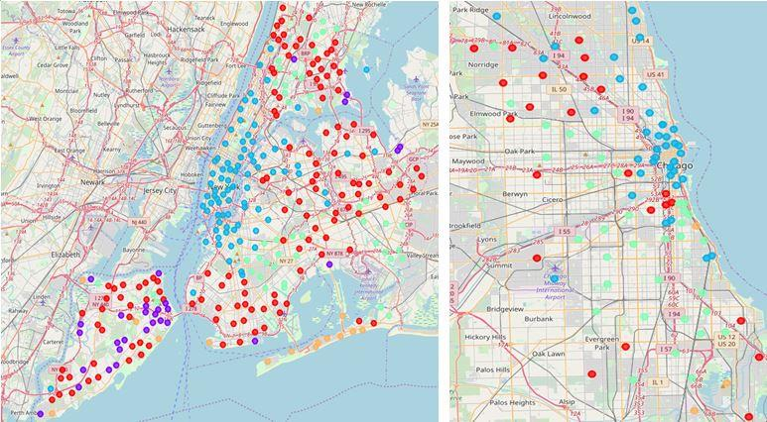
Neighborhood Similarity Between NYC and Chicago
Wansu Zhan
11/25/2018

Slide 2
Contents
Introduction
Data Description
Methodology
Results
Discussion
Conclusion

Slide 3
Introduction
This project tries to answer such question from the neighborhood similarity perspective
One common question Chicago based firms are asked by candidates from New York is that how Chicago compared to New York, or vice versa.
This project tries to approach this problem from the neighborhood similarity perspective

Slide 4
Introduction
This project tries to answer such question from the neighborhood similarity perspective
Two questions we would like to answer:
(1) Is there similarity at all between New York and Chicago neighborhoods?
(2) If there is, which neighborhoods between New York City and Chicago are similar to each other?

Slide 5
Data Description
This project tries to answer such question from the neighborhood similarity perspective
Two types of data used in this project
(1) Neighborhoods and their coordinates for New York and Chicago
The total numbers of distinct neighborhoods for New York and Chicago are 302 and 119 respectively
(2) Nearby venues information for each neighborhoods (via Foursquare API)

Slide 6
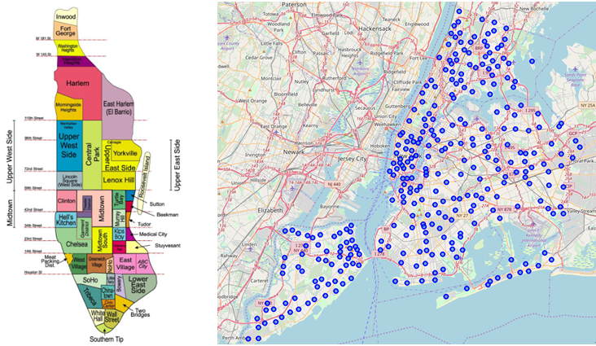
Methodology
This project tries to answer such question from the neighborhood similarity perspective
Neighborhood Exploration
New York

Slide 7
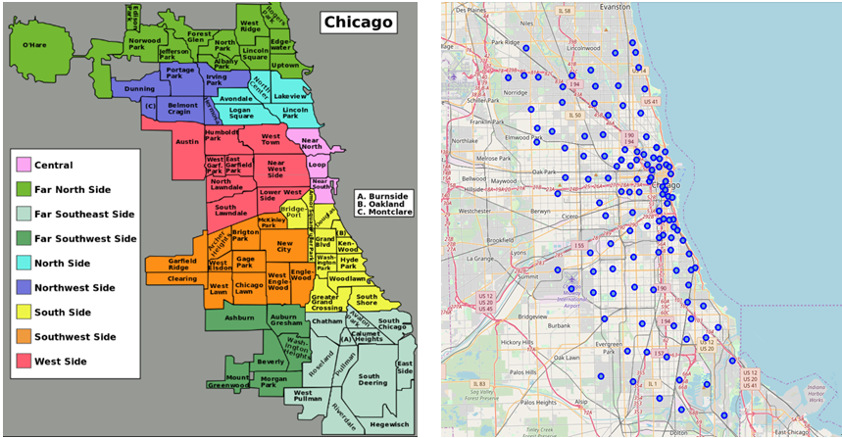
Methodology
This project tries to answer such question from the neighborhood similarity perspective
Neighborhood Exploration
Chicago

Slide 8
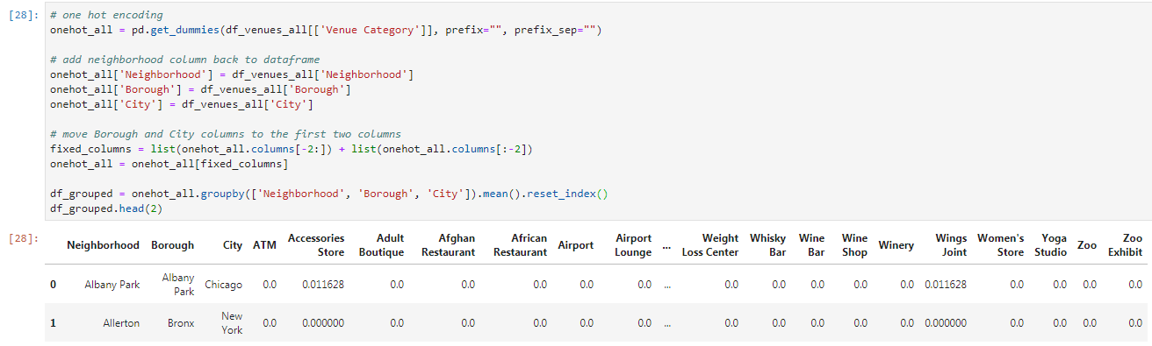
Methodology
This project tries to answer such question from the neighborhood similarity perspective
Venues Exploration

Slide 9
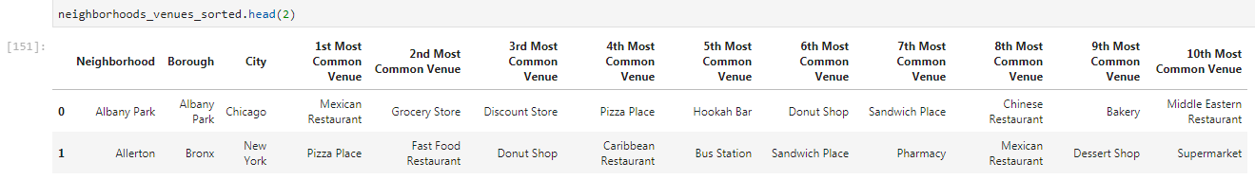
Methodology
This project tries to answer such question from the neighborhood similarity perspective
Venues Exploration

Slide 10
Methodology
This project tries to answer such question from the neighborhood similarity perspective
Clustering
Cluster analysis or clustering is the task of grouping a set of objects in such a way that objects in the same group (called a cluster) are more similar (in some sense) to each other than to those in other groups (clusters).
One of the simplest models among clustering approaches is K means
We will first perform cluster analysis for all neighborhoods of New York and Chicago. Then we will perform cluster analysis for only the downtown area of New York and Chicago

Slide 11
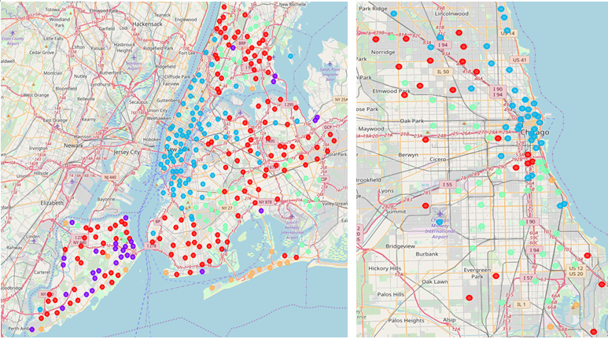
Results
This project tries to answer such question from the neighborhood similarity perspective
Using All Neighborhoods

Slide 12
Results
This project tries to answer such question from the neighborhood similarity perspective
Using All Neighborhoods
There are indeed similarities between New York and Chicago neighborhoods
Manhattan area is very similar to Chicago downtown area, as indicated by blue dots in the graphs
Some New York neighborhoods in Bronx, Staten Island, Brooklyn and Queens are similar to neighborhoods in Chicago suburbs in the south and west, indicating by red dots and green dots
Some neighborhoods in Staten Island at New York is not similar to any Chicago neighborhoods, as indicated by purple dots

Slide 13
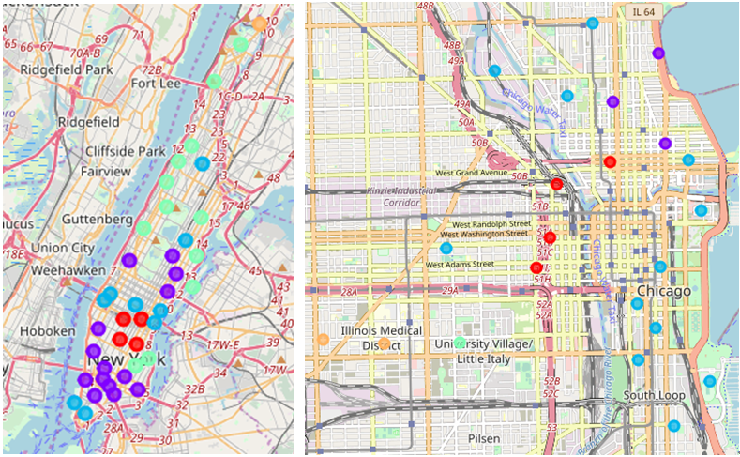
Results
This project tries to answer such question from the neighborhood similarity perspective
Using Downtown Neighborhoods Only

Slide 14
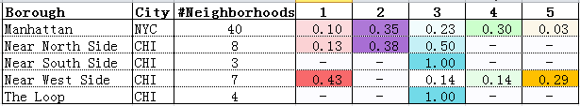
Results
This project tries to answer such question from the neighborhood similarity perspective
Using Downtown Neighborhoods Only

Slide 15
Results
This project tries to answer such question from the neighborhood similarity perspective
Using Downtown Neighborhoods Only
Explore Cluster2 Further
As indicated by purple dots,
New York neighborhoods in lower Manhattan, such as Soho and Little Italy, as well as some neighborhoods in the middle of Manhattan, such as Lincoln Square and Upper East Side, are similar to Chicago neighborhoods in the near north, such as Magnificent Mile and Gold Coast
* One can find further examination of each cluster in the Word report. In this presentation we will only use Cluster2 as an illustration example

Slide 16
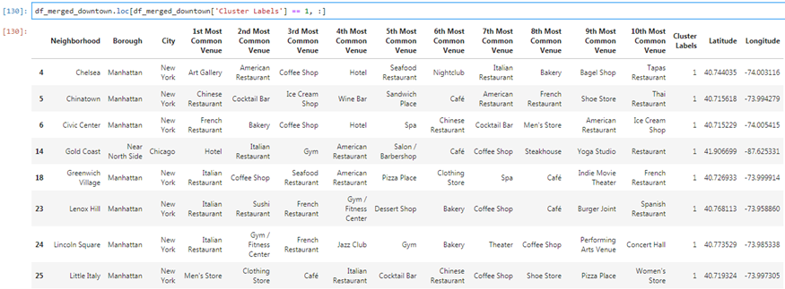
Results
This project tries to answer such question from the neighborhood similarity perspective
Using Downtown Neighborhoods Only
Explore Cluster2 Further
Top 10 common venues for neighborhoods that belong to this cluster:

Slide 17
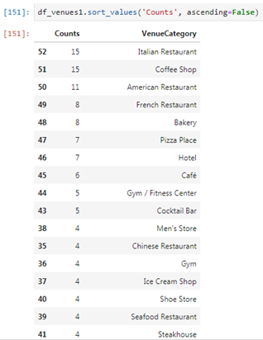
Results
This project tries to answer such question from the neighborhood similarity perspective
Using Downtown Neighborhoods Only
Explore Cluster2 Further
Venues that appear in the top 10 categories by frequency for this cluster :

Slide 18
Results
This project tries to answer such question from the neighborhood similarity perspective
Using Downtown Neighborhoods Only
Explore Cluster2 Further
Full list of the 17 neighborhoods belong to this cluster:
New York:
Chelsea, Chinatown, Civic Center, Greenwich Village, Lenox Hill, Lincoln Square, Little Italy, Lower East Side, Noho, Soho, Sutton Place, Tribeca, Upper East Side, West Village
Chicago:
Gold Coast, Magnificent Mile, Near North Side

Slide 19
Discussion
This project tries to answer such question from the neighborhood similarity perspective
The similarity in this analysis is all based on the proportion of nearby venues categories.
If one has more time, we can further investigate the similarity between neighborhoods of the two cities from different angles.
Using similar venue dataset, we can explore similarity using convenience score, or focusing on specific venues, like restaurants.
Using different dataset, we can explore similarity of neighborhoods from other perspectives, such as weather, relative house prices, lifestyle of people, etc.

Slide 20
Conclusion
This project tries to answer such question from the neighborhood similarity perspective
In this paper, we use K means to perform cluster analysis to help us understand the similarity of neighborhoods of New York and Chicago.
The data shows that there are indeed similarities among neighborhoods of these two cities.
When using all neighborhoods data
Manhattan is very similar to Chicago downtown area.
In addition, some New York neighborhoods in Bronx, Staten Island, Brooklyn and Queens are similar to neighborhoods in Chicago suburbs in the south and west. That being said, some New York neighborhoods, such as those in Staten Island, are not similar to any Chicago neighborhoods.
When using only downtown area data
We further identified the similarity between New York and Chicago neighborhoods.
For example, New York neighborhoods in lower Manhattan, such as Soho and Little Italy, as well as some neighborhoods in the middle of Manhattan, such as Lincoln Square and Upper East Side, are similar to Chicago neighborhoods in the near north, such as Magnificent Mile and Gold Coast.

Slide 21
Conclusion
This project tries to answer such question from the neighborhood similarity perspective
The work should help interested readers to understand the neighborhood similarity between New York and Chicago from nearby venue categories perspective.
Given more time, one can further explore the similarities from different perspectives, as mentioned in the Discussion section above.

Slide 22
Thank you!

